Slide 1
POST HARVEST TRANSPORATATION AND STORAGE
Mrs. Rajesh Kumari
Deptt. Of Food Technology
CBL Govt. Polytechnic, Bhiwani

Slide 2
POST HARVEST TECHNOLOGY
The two main objectives of applying postharvest technology to harvested fruits and vegetables are to maintain quality (appearance, texture, flavour, nutritive value and safety) and to reduce losses between harvest and consumption.
Effective management during the postharvest period, rather than the level of sophistication of any given technology, is the key in reaching the desired objectives.
While large scale operations may benefit from investing in costly handling machinery and high-tech postharvest treatments, often these options are not available to small-scale handlers for the simple reason of economies of scale. Instead, simple, low cost technologies can be more appropriate for small volume, limited resource commercial operations, farmers involved in direct marketing, for home gardeners, as well as for handlers in developing countries.

Slide 3
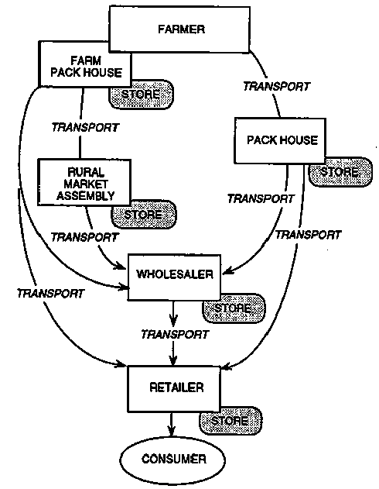
POST HARVEST HANDLING STEPS FOR A TYPICAL COMMODITY

Slide 4
HANDLING

Slide 5
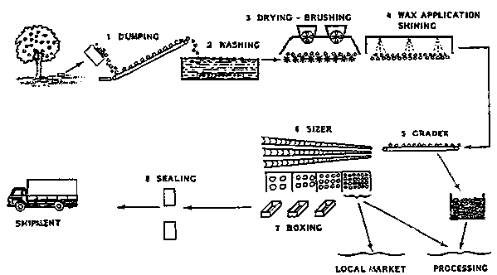
POST HARVEST HANDLING
Quality of harvested commodities cannot be further improved but it can be retained till their consumption if the rate of metabolic activities are reduced by adopting the appropriate post harvest handling operations.

Slide 6
Post harvest handling operations
HARVESTING
PRE-COOLING
SORTING
WASHING
WAXING/CHEMICAL TREATMENT
SIZING
PACKAGING
STORAGE
TRANSPORTATION
WHOLESALER
RESTORING, RESIZING & REPACKAGING
TRANSPORTATION
RETAILER
CONSUMER
FRUITS
HARVESTING
PRECOOLING
CLEANING
TRIMMING
GRADING
SORTING
CURING
SIZING
WAXING
PACKAGING
TRANSPORTATION
WHOLESALER
TRANSPORTATION
RETAILER
CONSUMER
STORAGE
VEGETABLES

Slide 7
1. PRE-COOLING-
Removal of field heat from commodities, also reduces bruise damage from vibration during transit. Cooling requirement varies with the air temperature during harvesting, stage of maturity and nature of crop.
COOLING METHOD | COMMODITY
Room cooling | All fruits and vegetables
Forced air cooling | Fruits and fruit type vegetables, tubers and cauliflower
Hydrocooling | Stem, leafy vegetable, some fruits and fruit type vegetables
Package icing | Roots, stem, some flower type vegetables, green onions and brussel sprouts
Vacuum cooling | Some stem, some flower type vegetables
Transit cooling Mechanical refrigeration Top icing & channel icing | All fruits and vegetables Some roots, stems, leafy vegetables and cantaloupes
Table- METHODS OF COOLING

Slide 8
2. WASHING, CLEANING AND TRIMMING
Cleaning methods includes removal of soil dust, adhering debris, insects and spray residues, fungicides like Diphenylamine (0.1-.025%) or Ethoxyquin (0.2- 0.5%) may be used as superfical scald. For cleaning of some fruit type vegetables (melons, brinjals, tomatoes, cucumber) they should be wiped with damp cloth. Some vegetables need trimming, cutting and removal leaves or other vegetative parts.
3. SORTING, GRADING AND SIZING
Sorting done by hand to remove fruits which are unsuitable to market and storage due damage by insects, diseases or mechanical injuries. Remainder crops is separated into two or more grades on basis of colour, shape or visible defects. For example, in apple packaging in India; its graded in 3 grades viz. Extra Fancy, Fancy and standard maybe packaged for marketing. The fourth being ‘’cull’’ grade is meant for processing. After sorting and grading, sizing is done either by hand or machine. Machine sizer works on two principles- weight and diameter.
Sizing based on fruit shape and size are most effective for spherical (Oranges, Tomato) and elongated (European pears).

Slide 9
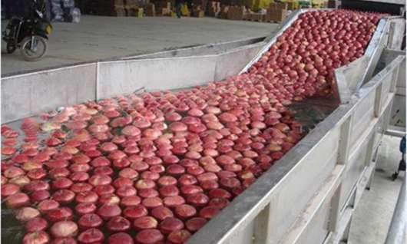
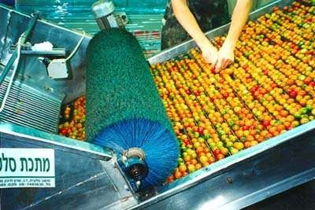
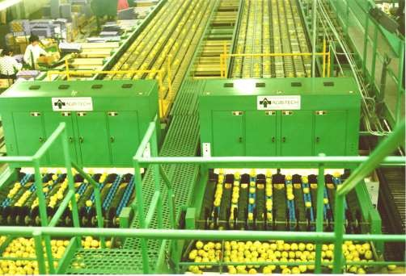

Slide 10
4. CURING
Effective operation to reduce water loss during storage from hardy vegetables viz. Onion, Garlic, Sweet potato and other tropical root vegetables. Curing of root and tuber crops develops Periderms over cut, broken or skinned surfaces wound restoration. Helps in healing of harvest injuries, reduce loss of water and prevents infection by decay of pathogens. Curing of onion and garlic are done to dry necks and outer scales, the bulbs are left in the field after harvesting under shade for a few days until the green tops, outer skins and roots are fully dried.
Commodity | Temp °c | Rh | Curing time
Irish Potato | 13-17 | >85 | 7-15
Sweet Potato | 27-33 | >90 | 5-7
Yam | 32-40 | >90 | 1-4
Onion and Garlic | 35-45 | 60-75 | 0.5-1
Cassava | 30-35 | >80 | 4-7
Table- Optimum condition for curing some vegetables

Slide 11
5. WAXING
Quality retention is a major consideration in modern fresh fruit marketing system. Waxes are esters of higher fatty acid with monohydric alcohols and hydrocarbons and some free fatty acids. Waxing reduces transpiration and respiration rates, but other chemicals such as fungicides, growth regulators, preservatives can be incorporated specially for reducing microbial spoilage, sprout inhibition etc.
ADVANTAGES-
Improved appearance
Reduces moisture losses and retards wilting and shrivelling during storage
of fruits
Less spoilage due to chilling injury and browning
Cost effective
DISADVANTAGE-
Development of off-flavour
Attributed to inhibition of O2 and CO2 exchange, resulting in anaerobic respiration and elevated ethanol and acetaldehyde content.

Slide 12
TYPES OF WAXES-
Solvent waxes- For citrus fruits consists of 70-80% aliphatic hydrocarbon and upto 25% aromatic hydrocarbons and solvents such as acetone, ethyl acetate.
Water waxes- resin solution waxes and emulsion waxes, resin solution waxes are solution of one or more alkali-soluble resin or resin-like materials such as natural gums or wood resin. Emulsion waxes are composed of natural wax such as carnauba or paraffin or synthetic wax such as polyethylene emulsion.
Paste or oil waxes- often used on vegetables, mainly composed of paraffins that are different in melting point and blended to a desired viscosity.
CATEGORIES OF WAX ACCORDING TO THEIR USAGE-
  STORAGE WAX- when fruit is not be marketed immediately
  PACK OUT WAX- when fruits are to be marketed immediately
  HIGH SHINE WAX- for giving a very high grace on market demand

Slide 13
LIST OF WAXES USED COMMERCIALLY
Paraffin wax
Carnauba wax
Bee wax
Micro crystallising waxes
Shellac
Wood resins
POLYETHYLENE (oxidized polyethylene wax or hydrocarbon wax)
TRADE NAME OF SOME EXTENSIVELY USED WAXES
Decco luter
Fruit and vegetable kleen
Frutox-emulsion of different waxes with 12% solids

Slide 14
6. PACKAGING
Proper packaging reduces wastage of commodities by protecting them from mechanical damage, dirt, moisture loss and other undesirable physiological changes and pathological deterioration during the course of storage, transportation and subsequent marketing.
Packaging cannot improve the quality of the product but helps in maintaining it, as protects against the hazard of the journey.
To provide uniform quality to packed produce, commodity should be carefully supervised and sorted prior to packaging.
Packaging boxes- wooden crates, woven baskets, jute sac, plastic punnets, corrugated fibre board boxes.

Slide 15
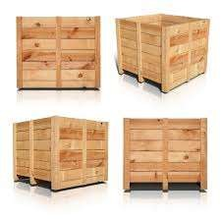
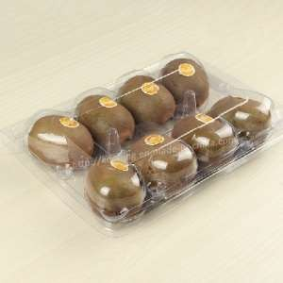
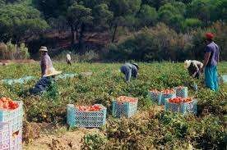
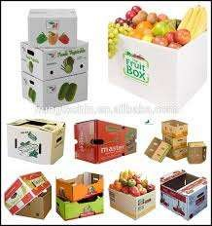
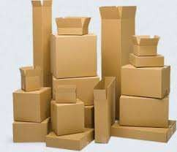
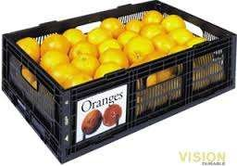

Slide 16
PACKAGING MATERIAL | SPECIALITY
CORRUGATED FIBRE BOARD (CFB) BOXES | Light in weight, easy to handle , hygienic and recyclable. Made water proof by use of suitable adhesive or wax coating or a plastic film
COMBINATION BOXES | Made with plywood and CFB, gives high stack load capacity
PLASTIC TRAYS OR CRATES | Hygienic, light in weight, sturdy and recyclable and used in multi-trip packaging
MOULDED PULP TRAYS OR THERMOFORMED PLASTIC TRAYS | Cavities to hold individual apple fruit, prevents fruit from rubbing against each other often leads to surface cracks.
STRETCH WRAPPING | Retail marketing of fresh produce in form of cling plastic films
MODIFIED ATMOSPHERIC PACKAGING | Internal atmosphere can be optimized using mixture of gases like O2, N2, and CO2

Slide 17
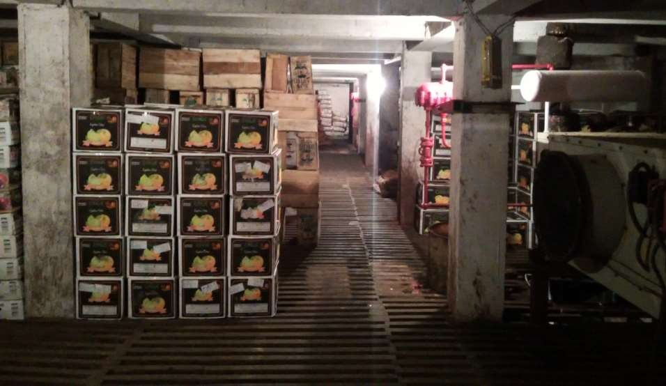

Slide 18
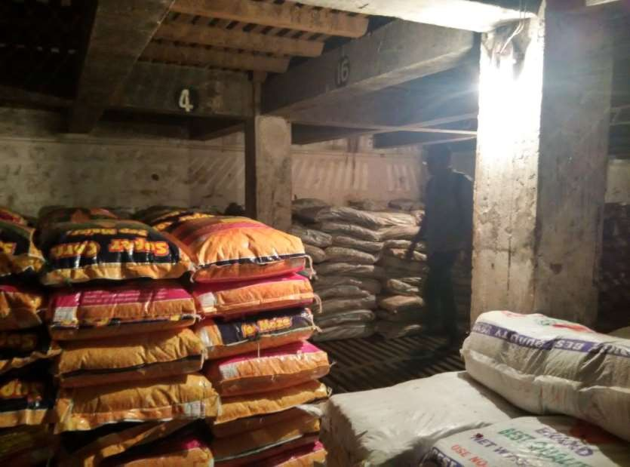

Slide 19
TRANSPORTATION

Slide 20
The main aim of transportation is to move perishable products with minimum loss of quality. Most transportation equipment controls air temperature around the product.
Horticultural produce maybe carried by road, rail, sea or air.
High value perishables are transported by airr
Ship- frozen meat, chilled carrots packaged in blocks and cartons
Principles of ventilation, refrigeration, modified atmosphere applying to transportation similar to storage.

Slide 21
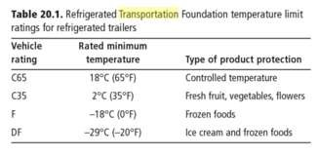

Slide 22
TRANSPORTATION BY RAIL- Takes 7-10
days, used for transport of potatoes, carrots, onions, citrus fruits.
TRANSPORTATION BY AIR- Short transit times, expensive, provides poor temperature control compared to refrigerated land and sea transport methods. Used for transportation early season cherries, cut flowers, strawberries and some tropical fruits.

Slide 23
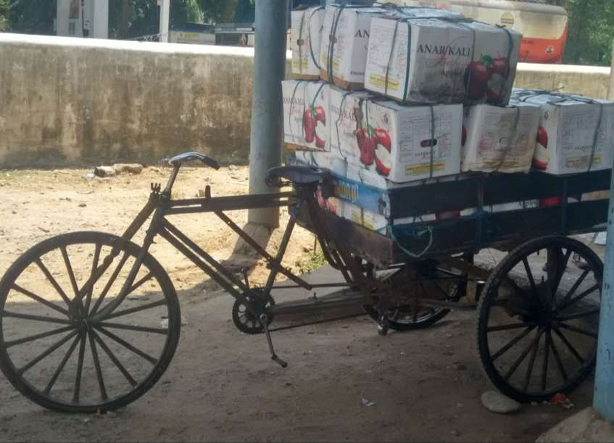

Slide 24
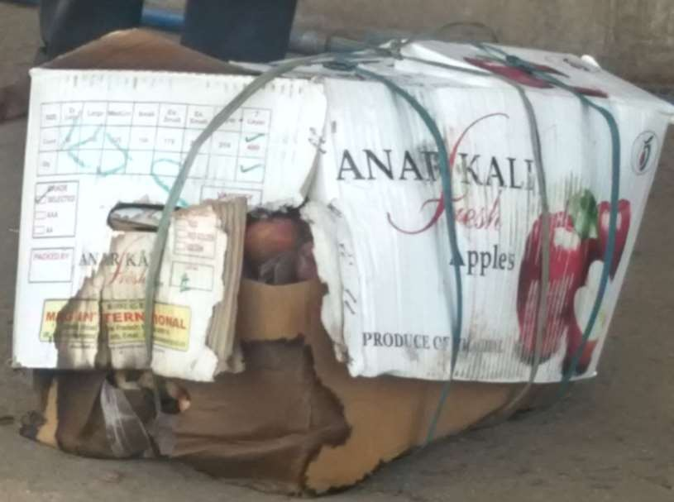

Slide 25
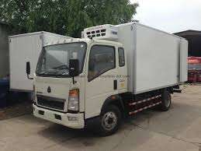
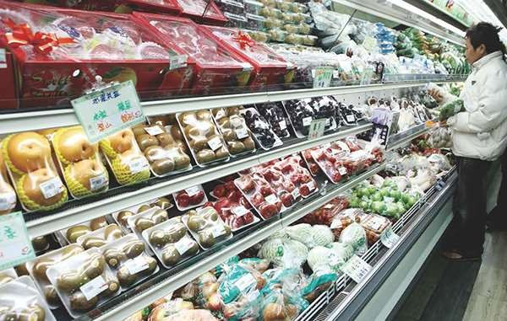

Slide 26
REFERENCES
http://www.fao.org/wairdocs/x5403e/x5403e02.htm http://www.fao.org/wairdocs/x5403e/x5403e05.htm https://books.google.co.in/books?hl=en&lr=&id=O1zhx2OWftQC&oi=fnd&pg= PA1&dq=post+harvest+transportation&ots=4gyY2_ygJL&sig=bETu- LUUHg4W36Jd1dzV6St6L3w#v=onepage&q=transportation&f=false

