Slide 1
Food preservation
Jai Singh
Deptt. Of Food Technology
CBL Govt. Polytechnic, Bhiwani

Slide 2
Principles of food preservation
Prevention or delay of microbial decomposition
Prevention or delay the self decomposition of the food
Prevent the damage cause by insects, animals, mechanical etc.

Slide 3
Applications of microbial growth curve to food preservation
 Microbial decomposition of foods will be prevented if all spoilage organisms are killed and recontamination is prevented by:
Predict microbial growth of food spoilage. Eg: Salmonaella
Control at any course. Eg: growth rate, lag time, generation time
 Hindering the growth of microorganisms by merely stopping the multiplication does not necessarily prevent decomposition because there is possibility that viable organisms or their enzymes may continue to be active.

Slide 4
Methods of food preservation
Asepsis- keeping out microorganisms
Removal of microorganisms
Maintenance of anaerobic condition
Use of high temperature
Drying and smoking
Use of chemical preservatives
Irradiation

Slide 5
Asepsis
 Natural protection - outer layer of animal and plant tissue protects the inner layer free from microorganisms. This protective covering will delay / prevent microbial decomposition e.g. shells of nuts, skins of fruits and vegetables etc.
Packaging of foods - such as wrapping, hermetically sealed containers. This methods will prevents primarily contamination during handling.
Sanitary methods of handling and processing foods e.g. in the dairy industry, contamination with microorganisms is avoided as much as possible in the production and handling of milk.
Food industries - attention is given to prevention of the contamination of foods (from raw material finished products) concerning the "bioburden" of microorganisms on or in a food.

Slide 6
BIOBURDEN
Kinds of microorganisms present whether any spoilage or pathogenic microorganisms.
Number of microorganisms.
Spoilage organisms food spoilage
Difficult to preserve
Aim: to measure the total number of viable microbes (total microbial count) on a food prior to its final sterilization before use.

Slide 7
Removal of microorganisms
Filtration
The only successful method for complete removal by using a pre- sterilized filters e.g. in fruit juices, soft drinks and water.
Centrifugation
Not very effective because not all microorganisms are removed, examples: Treatment of drinking water- remove heat resistant bacteria from milk
Washing
Especially helpful in removing soil microorganisms from fresh fruits and vegetables that may be resistant to heat process during canning.- water not contaminator.
Trimming
Trim away spoiled portions of a food.

Slide 8
Maintenance of anaerobic conditions
Anaerobic conditions can be achieved by a complete fill, replacement of air by C0₂ or N₂ and others.
Spores are resistant to heat and may survive in canned food but they unable to germinate in the absence of oxygen.

Slide 9
Use of high temperatures
Temperature and time used in heat processing will depend on:
The effect of heat on the food
Other preservative methods employed
Heat Treatment ↑
Microorganisms
↓
Classification of heat treatments used on foods:
Pasteurization (below 100°C)
Heat at 100°C
Heat > 100°C

Slide 10
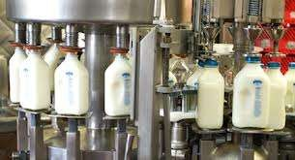
a. Pasteurization
Heat treatments that kills most but not all microorganisms.
Example: milk 63ºC, 30 mins
72ºC, 15 mins Juice 77ºC, 30 mins
88ºC, 30 secs
The pasteurized products are cooled promptly after the heat treatment.

Slide 11
Pasteurization is important when:
Heat treatment will not harm the quality of product
Main spoilage microbes are not very heat resistant
e.g. yeast in fruit juices
Kill pathogens
Any surviving organisms will be treated with other preservative methods
Competing organisms are to be killed, allowing a desired fermentation

Slide 12
Preservative methods used to supplement pasteurization:
Refrigeration.
Keeping out microorganisms by packaging.
Maintenance of anaerobic conditions.
Addition of high concentration of sugar.
Presence of chemical preservatives

Slide 13
b) Heating at about 100°C
Sufficient to kill all microbes but not spores,
Many acid foods are successfully preserved at100°C.
Methods
©Boiled ©Immersion ©Baking
©Simmering © Roasting
© Frying © Blanching © Exposure to flowing steam

Slide 14
c) Heating above 100°C
 Obtained by means of steam under pressure
Steam pressure if ↑ Temp. ↑
121°C. 1 atm.
Commercial sterility: include heating foods at high temperature for a short time e.g. ultra heat treatment.
All commercially sterile foods should be stored in cool, dry, place to prevent any viable thermophilic spores from germinating and cause, spoilage to the foods.
Ultra Heat Treatment: Treatment of milk by heating at 150°C by steam injection followed by 'flash evaporation' of the condensed steam.

Slide 15
Objective of heating foods:
To destroy pathogens and spoilage microorganisms
To destroy toxin present in foods
To destroy the vegetative cells and spores of yeast, bacteria and moulds
To destroy undesirable enzymes this can affect the quality of foods.
To control the growth of surviving microorganisms
To retain the acceptance and nutritional quality of foods
To reduce competition

Slide 16
Canning process
Preservation of foods in sealed containers followed by application of heat treatment.
Canning (also known as hermetically sealed containers) is done in tin cans, glass containers, aluminum and plastic pouches.

Slide 17
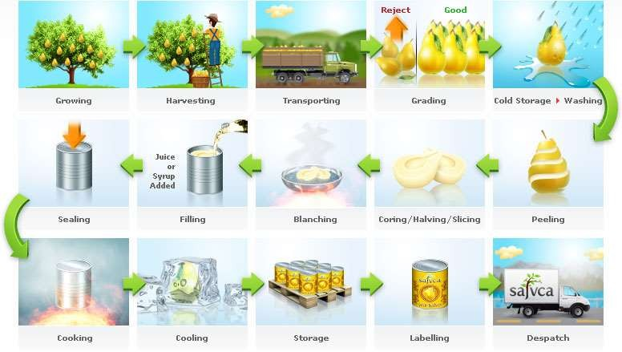

Slide 18
Spoilage of canned food can be divided into 3 types:
Microbial spoilage
Chemical spoilage
Enzymatic spoilage
 In general, microbial spoilage can occur due to under processing and/or leakage after processing.

Slide 19
Types of spoilage in canned food depends on the type of microorganisms involved:
1. Thermophilic bacteria and spores
These bacteria can cause 3 types of spoilage especially when cans are kept at > 43°C.
"Flat-sour" spoilage
Thermophilic Anaerobe Spoilage
Sulphide stinker spoilage

Slide 20
2. Mesophilic bacteria
Bacillus spp.
Clostridium spp.
e.g.: C. sporogenes.
3. Non-spore forming bacteria
E.g. Streptococcus, micrococcus etc. which will produce acid and gas.
4. Moulds and Yeasts
 can be killed by mild heat.

Slide 21
Use of low temperature
Low temperature reduces the activity of microorganisms by reducing
the chemical reaction and action of enzymes.
-low temp will prevent growth of m/o allowing only small metabolic activity.
Hence, less microbial growth and spoilage' is delayed / prevented.
A. Chilling temperature
Temperature of 6°C can prevent the growth of food poisoning microorganisms except the Clostridium botulinum type E and retard the growth of spoilage microorganisms.
Chilling temperature is the main method for temporary preservation
of food.
Psychrotroph are microorganisms which can grow at low temp. e.g. Flavobacterium spp. & Pseud. alcaligenes but they have a low growth rate.

Slide 22
B.
Freezing temperature
Cause reduction in number of viable microorganism but does not sterilize the food.
The percentage of microorganisms killed during freezing and storage varies depending on:
Substrate (kind of food)
Type of freezing
Advantages of fast freezing
Smaller ice crystal form - less mechanical destruction to food
Short period of solidification - sudden death to microorganisms and quick inactivation of the enzymes.
Food quality after thawing is better

Slide 23
Drying and smoking
A. Drying
 Methods which lower the water content of food to a point where the activities of enzymes and food spoilage and food poisoning microorganisms are destroyed / inhibited.
The lower the water activity of food, the greater is the inhibition.
If Aw is between 0.75 - 0.70, the spoilage is delayed. If Aw is 0.65, the spoilage is
most unlikely to occur up to 2 years.
Molds and yeasts are more important in spoilage dried foods since bacteria require higher water content for growth.
e. g. Streptomyces rouxii Aw 0.65
Aspergillus glaucus Aw 0.60

Slide 24
Types of drying:
Sun drying
Spray drying
Free drying
Smoking
Treatment before drying (to reduce number of microorganisms):
Washing
Dipping food in alkaline solution
Treatment with S02 (1000-3000 ppm)
Blanching/ scalding

Slide 25
Effects of drying upon foods.
Desiccated foods are subjected to certain chemical changes which can cause undesirable product:
(a) Dried food that contains fat and oxygen can cause oxidative rancidity to occur.
(b)
Dried food which contains reducing sugar can undergo a color change called Maillard reaction. Carbonyl groups of reducing sugar react with amino groups of protein and amino acids followed by a series of complicated reaction. The browning is undesirable because of the unnatural color and bitter taste imparted to the food.
Loss of vitamin C
Discoloration
Toughness
Methods of minimizing the chemical changes in dried food:
Keep moisture content as low as possible
Reduce the level of reducing sugar as low as possible
Reduce serial blanching in the same water
Use S02 to retain vitamin C and avoid browning

Slide 26
B. Smoking
Heating foods using smoke from various types of wood to preserve foods.
The smoke produces heat which kills some microorganisms on the surface
Heat also reduces the Aw.
It also has an antimicrobial compounds e.g. formaldehyde which can inhibit
the growth of some microorganisms.
The presence of aromatic compounds will also give a distinctive flavor and around to the food.
This will make the foods taste better and more tender e.g. smoked fish.
Woodsmoke is more effective against vegetative cells than against bacterial spores.

