Slide 1
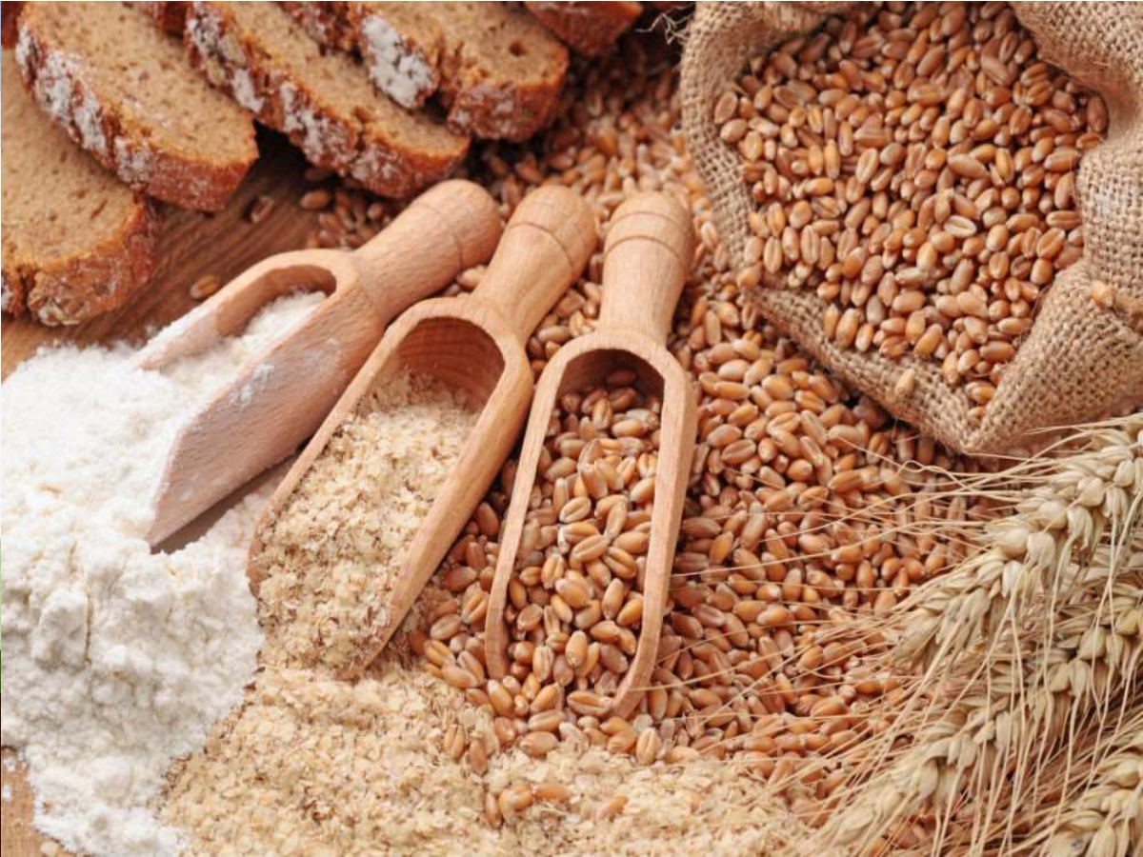
Wheat Milling
Kanchan
Deptt of Food Technology
CBL Polytechnic, Bhiwani

Slide 2
ABOUT WHEAT……..
Genus : Triticum Family : Gramineae
➢It is one of the most important cereal crops in the world
➢The wheat of commercial importance belong to:
1. Triticumaestivum(common hard wheat)
2. Triticum durum (durun wheat)
3. Triticum compactum (soft white wheat)

Slide 3
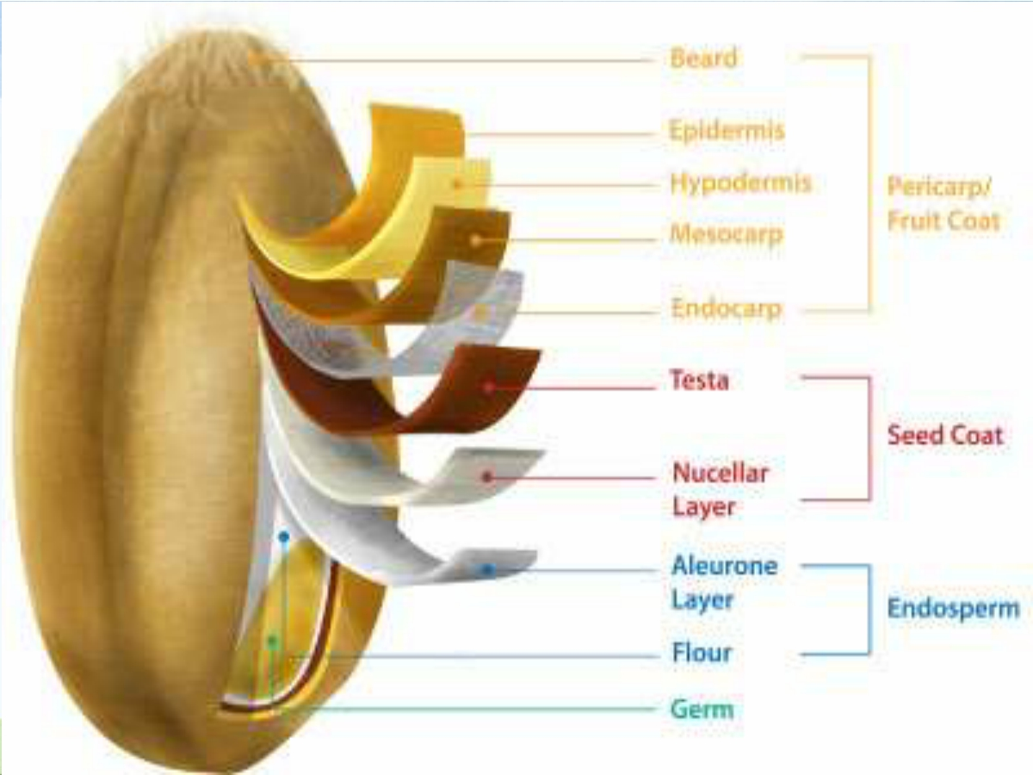

Slide 4
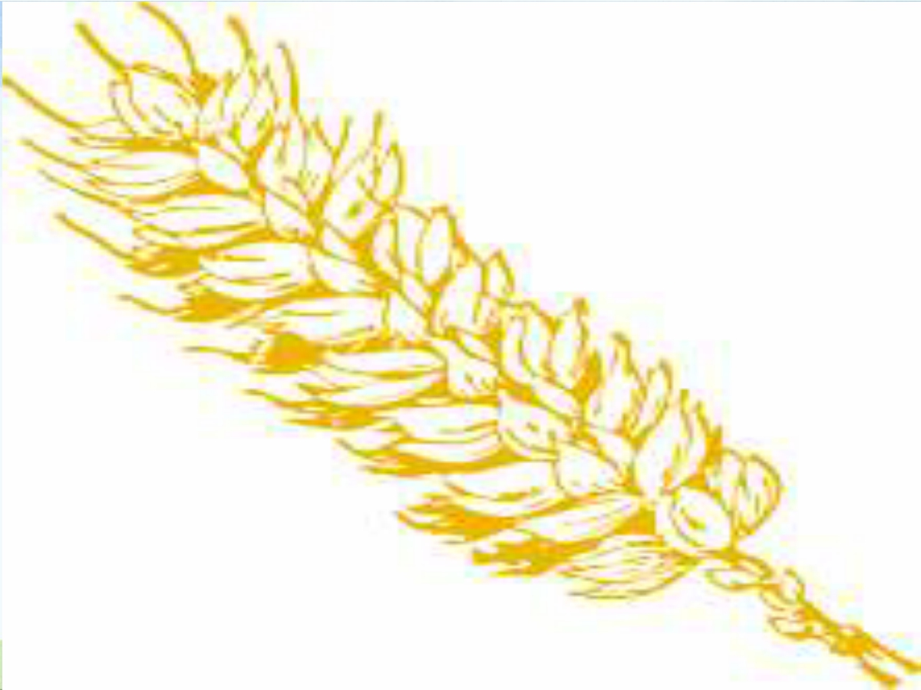
WHAT IS MILLING????????
➢Most cereal grains are used either for the production of animal feed or for the milling of flour for human consumption
➢The grinding of wheat for human consumption has to meet higher standards of quality and is called milling
➢The aim of milling is two fold;
1. to grind cleaned and tempered cereal
2. to completely separate the bran and germ from the mealy endosperm and to thoroughly pulverize the mealy endosperm into middings, semolina and flour in case of wheat.

Slide 5
NUTRIENT COMPOSITION
 | Whole grain | Endosperm | Bran | Germ
Protein | 16 | 13 | 16 | 22
Fat | 2 | 1.5 | 5 | 7
Carbs | 68 | 82 | 16 | 40
Dietary fiber | 11 | 1.5 | 53 | 25
Minerals | 1.8 | 0.5 | 7.2 | 4.5
others | 1.2 | 1.5 | 2.8 | 1.5

Slide 6
WHEAT MILLING
➢Wheat is commonly consumed in the form of flour obtained by milling the grain while a small quantity is converted into breakfast foods, such as wheat flakes, puffed wheat and shredded wheat
➢Two types of milling process are;
1. traditional milling
2. modern milling

Slide 7
TRADITIONAL MILLING
➢The traditional procedure for milling wheat in India has been stone grinding (chakki) to obtain whole meal flour (Atta)
➢This method results in 90-95% extraction rate flour which retains almost all the nutrients of the grain while simultaneously eliminating that part of the grain which is most indigestible like cellulose and phytic acid which binds and carries away minerals

Slide 8
MODERN MILLING

Slide 9
Grain cleaning:- grain is removed of various types of impurities together with damaged, shrunken and broken kernels which are collectively known as screenings
Conditioning or tempering:-
The process involves the addition or removal of moisture for definite period of time to obtain desired moisture content in grain
Breaking:- wheat grains are passed through break rolls. Grains are cracked
Sifting:- after each set of break rolls is a sifting machine, is a combination of sieving operations and air aspirations

Slide 10
Purifying:- it consist of a long oscillating sieve inclined downward, through which the air current is passed in the direction of floor to ceiling. Flour gets stratified into bran and middings of different size
Reduction:- these reduce the endosperm middings to flour size and facilitate removal of the remaining particles
Scratching:- in addition to break and reduction system, a scratch system is system is sometimes used as a standby to maintain proper release of endosperm from bran
Entoleter:- the stock from earlier reduction roll is treated on specially devised entoleter machine
Air classification:- finished product from roller mill is further reduced in special grinders moving at high speed

Slide 11
MILLING QUALITY
In commercial mill, the aim is to obtain a maximum yield of flour with a healthy white color
Lower the ash content the white the flour
The milling quality is determined by successively measuring the following characteristics in a standard milling equipment;
1)the amount of grain that can be milled per unit
time
2) the flour yield of each milling passage
3) the moisture and ash content of each milling
passage

Slide 12
Milling of soft wheat v/s hard wheat
SOFT WHEAT
o The mealy endosperm is fragmented indiscriminately.
o When rubbed between thumb and forefinger, the flour has a soft, wooly feel.
o The flour of soft wheat contains many loose starch granules and protein particles due to the low degree of cohesion between starch and particles
HARD WHEAT
o Fracturing of the grain follows the middle lamellas of the mealy endosperm cells.
o As the cohesion between starch and protein is much stronger in hard than in soft endosperm, the flour contains hardy any
loose starch granules and protein particles

Slide 13
Bleaching
flour contains a yellow pigment xanthophylls which is not desired in the making of white bread. When the
flour is exposed to air, the color of the flour is bleached by oxidation. When the flour is stored in bulk, this change is slow
Maturing
The bread making quality of freshly milled flour improves with storage for 1-2 months. A number of oxidizing agents are used at the mill as maturing agents
Eg; chlorine dioxide

Slide 14
PRIMARY PRODUCTS FROM MILLING
WHEAT
FLOUR
WHEAT
MILLING
SOOJI
OR
RAVA
ATTA
FLOUR
MAIDA
FLOUR

Slide 15
WHOLE WHEAT FLOUR
➢It contains the finely ground bran, germ, and
endosperm of the whole kernel
➢Whole wheat product have a distinctive flavor and
coarser texture than those made from white flour
➢Because of the higher fat content of the germ, whole wheat flour is more difficult to keep and sometime becomes rancid in storage

Slide 16
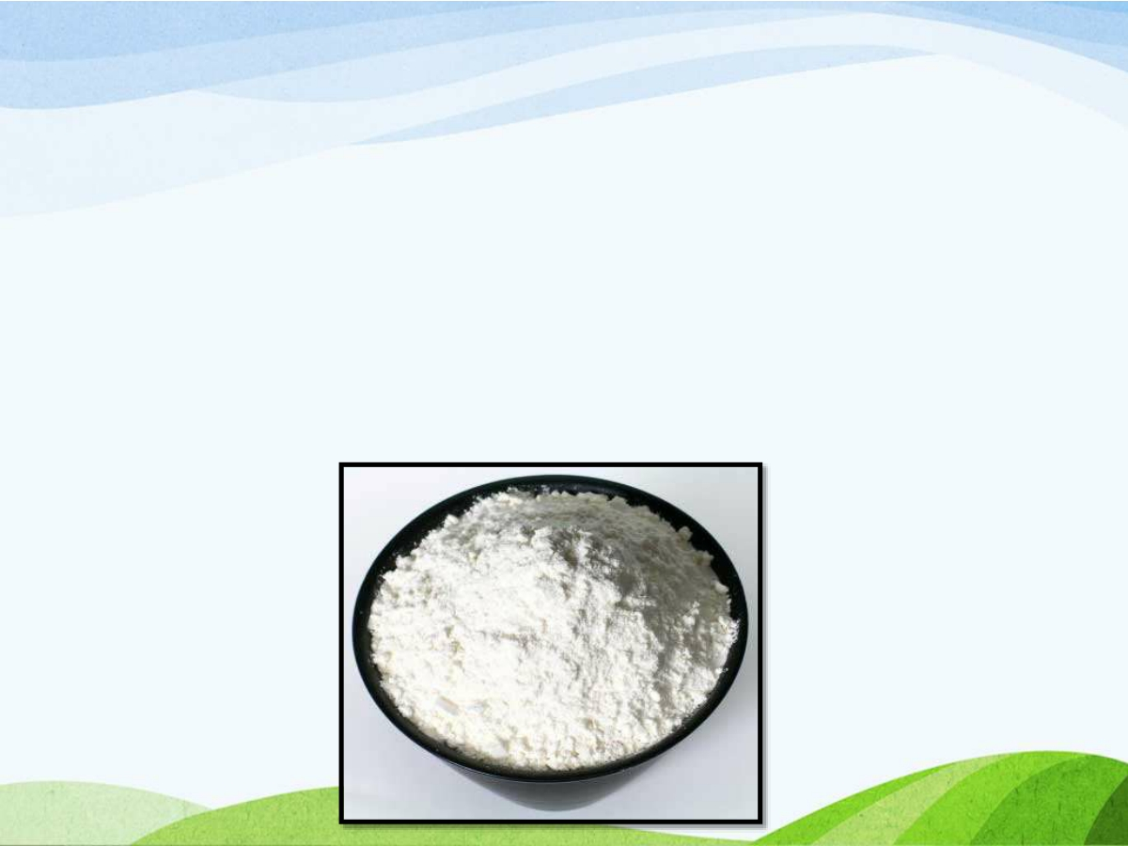
MAIDA
➢The bran and germ are separated in making white flour or Maida
➢Maida makes more bland in taste and more easily digested
➢It can be stored in an airtight container in the refrigerator

Slide 17
SEMOLINA
➢It is closely ground endosperm and its chemical composition is similar to that of white flour
➢
➢It is used in the manufacture of macaroni products
➢It is roasted before storing to save it from insects and corms

Slide 18
WHEAT BRAN
➢It increases the stool weight by increasing the water holding capacity of the bran
➢When bran products constipation and may lower the risk of colon cancer

Slide 19
Wheat berry
✓Is row, unprocessed wheat kernel containing the bran and germ and endosperm
✓These kernels double in volume when cooked in water and have a nutty taste, with a chewy but tender texture

Slide 20
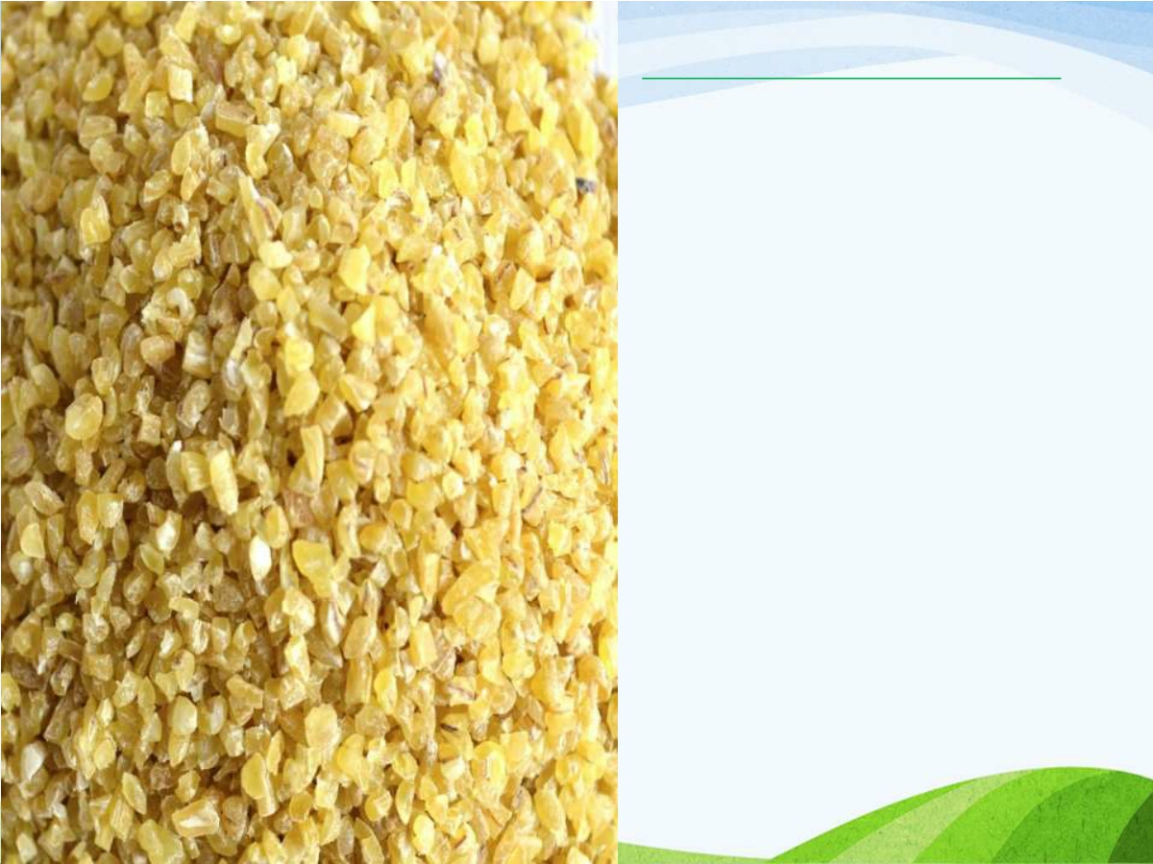
CRACKED WHEAT
✓Is created when row, unprocessed wheat berries are crushed or cut into small pieces
✓Cracked wheat is used in the production of cereals and can be used in casserdes, salads, stuffing and as a meat extender

Slide 21
Shredded products
✓Wheat is cooked in water to gelatinize starch
✓The conditioned grain is fed into shedders and material emerging as long parallel shreds are received on a slowly travelling band, a thick mat is built up by
the superimposition of several
layers
✓The mat is cut into desired shapes and baked at 260 C for 20 minutes

Slide 22
GRANULAR PRODUCTS
✓A dough is made of yeasted whole meal wheat flour and malted barley flour
✓The dough is fermented for about 5 hours and the bread is
baked
✓The bread is then broken up dried and ground to desired fineness

Slide 23
Biscuits, cookies, and confectionary products
✓These are low density baked products and require soft wheat
✓In biscuits and cookies making the wheat should not contain more than 13.5% moisture, and protein content of the flour should range between 7-8%
✓Other ingredients used are sweetening agents, shortening, emulsifiers, milk, salt and aerating agents etc.
✓Fruits and nuts are used for the taste and flavor

Slide 24
✓Hand made vermicelli is made with maida into very fine threads and is very popular as the vermicelli
✓Delicious payasam is made from this
✓It is very fast process and does not require any costly machinery or equipment

Slide 25
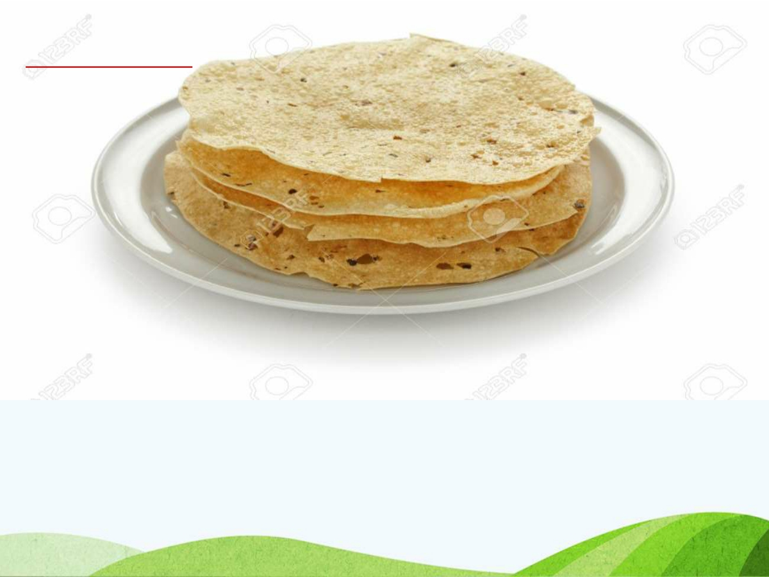
PAPPAD
▪Pappad is very popular
▪They are used as meal accompaniments especially on festive occasions
▪Leavening agent used is sodium bicarbonate

