Slide 1
1. Introduction to CNC machines
.\

Slide 2
Contents
Introduction to CNC
Operations in CNC
Advantages and Disadvantages of CNC
Axis selection
5 Axis CNC
Advantages and application of 5 axis
Types of machine configurations for 5-axis machining
Specification of a 5 axis CNC machine

Slide 3
Introduction to CNC
Numerical control (NC) is the automation of machine tools that are operated by precisely programmed commands encoded on a storage medium, as opposed to controlled manually.
Most NC today is computer numerical control (CNC), in which computers play an integral part of the control.
In modern CNC systems, end-to-end component design is highly automated using computer-aided design (CAD) and computer-aided manufacturing (CAM) programs.

Slide 4
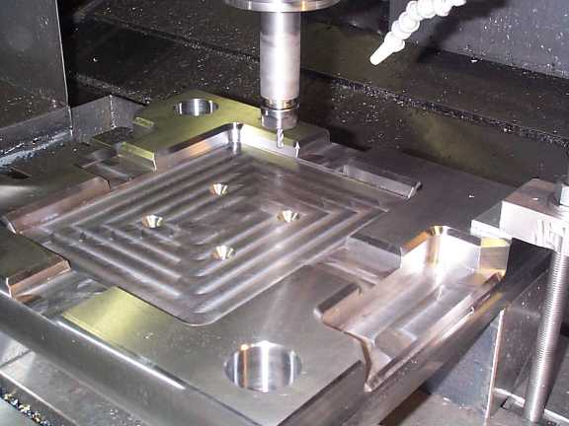
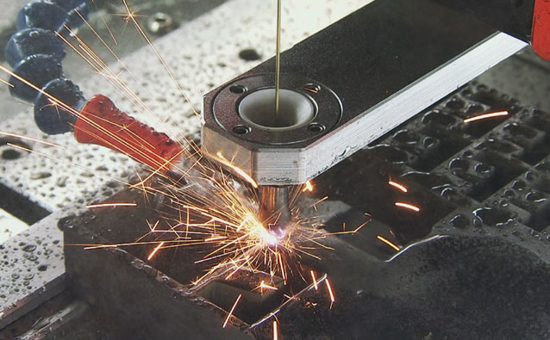
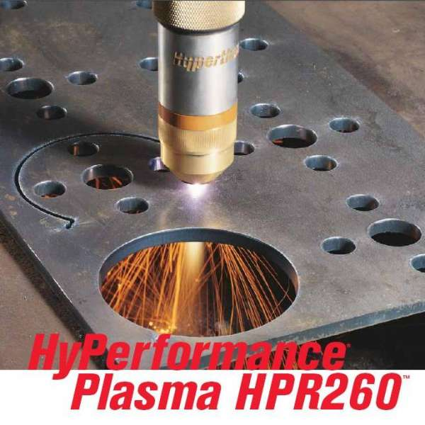
Operations in CNC
CNC Milling
CNC Plasma Cutter
CNC Electric Discharge Machining

Slide 5
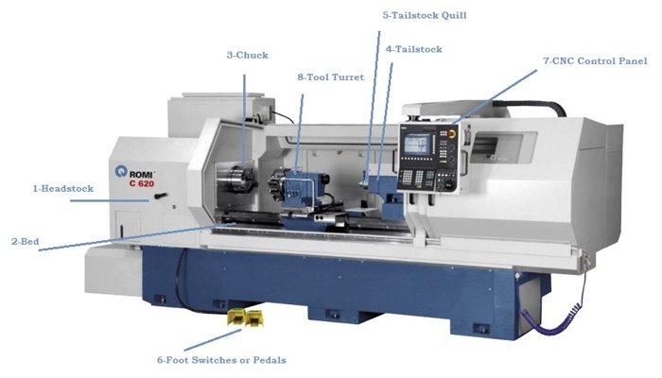

Slide 6
Other CNC Operations are:-
  CNC Water Jet Cutter
  Drilling
  Sheet metal works (Turret punch)
  Wire bending machines
  Surface grinders
  Cylindrical grinders
  submerged welding
  Glass cutting

Slide 7
Advantages of CNC
CNC machines can be used continuously
Batch production with high accuracy
can be updated by improving the software
Training in the use of CNCs is available through the use of ‘virtual software’.
Intricate detail machining
no need to make a prototype or a model
One person can supervise many CNC machines simultaneously
saves time

Slide 8
Disadvantages
more expensive than manually operated machines
The CNC machine operator only needs basic training and skills, enough to supervise several machines. In years gone by, engineers needed years of training to operate centre lathes, milling machines and other manually operated machines. This means many of the old skills are been lost.
Investment in CNC machines can lead to unemployment

Slide 9
Axes of CNC Machine Tool
Notes:
A axis of motion is defined as an axis where relative motion between cutting tool and workpiece occurs.
The primary axes of motion are referred to as the X, Y, and Z axes and form the machine tool XYZ coordinate system.
In CNC machine tool, each axis of motion is equipped with a driving device to replace the handwheel of the conventional machine tool.
Figure shows the coordinate system and the axes of motion of a typical machine tool.
Conventionally machine tools are designated by the number of axes of motion they can provide to control the tool position and orientation.
In these CNC machine tools, the tool is controlled along the three axes (X, Y, and Z) simultaneously, but the tool orientation doesn’t change with the tool motion .

Slide 10
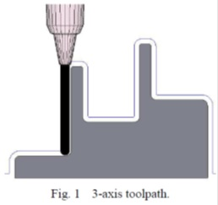
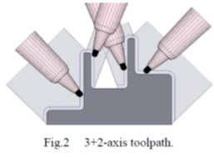
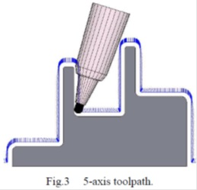
From 3-axis to 5-axis machining
dozens of views need to be defined
more tool movements
programming is quite difficult
sum of all views does not cover the
whole geometry
overlapping views lead to surface
quality problems
More number of lead-in and out
movements
not sufficient for the complete
finishing process for very deep part and having narrow cavities
results in a bad surface quality and long machining times in Case of harder material

Slide 11
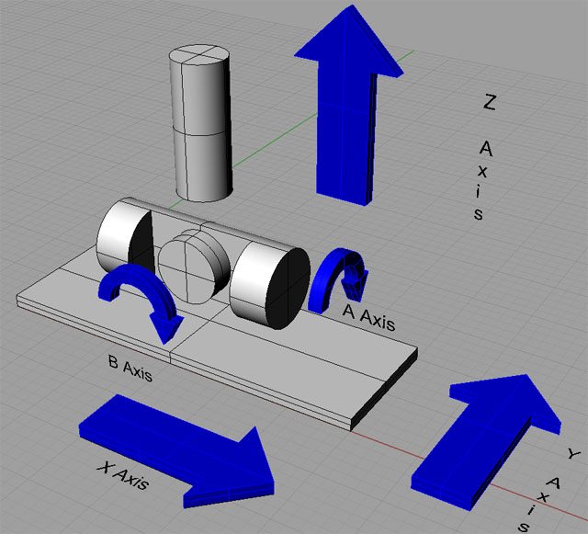
Five Axis CNC

Slide 12
ADVANTAGES OF 5 AXIS CNC
to machine complex shapes in a single setup
reduces the machinist setup time and increases production rates
By eliminating multiple set-ups, time and errors are reduced
the feature-to-features accuracy is improved because the same zero or datum reference frame is used throughout the manufacturing process
since simultaneous movement is allowed along the X and Y axis, shorter and more rigid tools may be used
higher spindle/cutting tool speeds may be achieved while reducing the load on the cutting tool
Shorter and thicker cutters also reduce vibration when machining deep pockets or contoured features with three-axis machines.

Slide 13
Application
complex three dimensional profiles
for impellers, turbine blades, and plastic mold tools

Slide 14
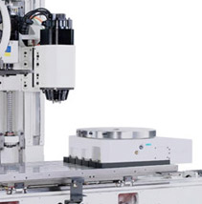
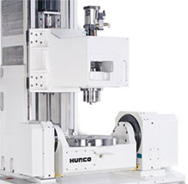
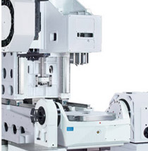
Types of machine configurations for 5-axis machining
Swivel Head with Rotary Table
Traveling Column
Integrated Trunnion Table

Slide 15
Specification of a 5 axis CNC Machine
Manufacturers
    HURCO
    TARUS
    CMS north America
    OKUMA
    CNC TAKANG Taiwan
    maximart corporation
    YCM (YEONG CHIN MACHINERY INDUSTRIES CO., LTD )

Slide 16
Specification cont…
TARUS TPGM5X1083 SPECIFICATIONS
Parameters
X Axis Travel | 3048 mm
Y Axis Travel | 2540 mm
Z Axis Travel | 1117 mm
Space between columns | 3886 mm
Workable size,L*W | 3568 mm*2235 mm
X , Y and Z axis maximum feed rate | 30m/min
A axes tip | +/-100 degrees
C axis tip | Continuous
A and C axis positioning peak torque | 4073 NM
A and C axis positioning Feed | 30 degrees per second
Milling Spindle | HSK 63A, 0-20,000 RPM (3 axis and 5 axis milling) 4,000 RPM base speed 70 NM constant torque,160 NM peak torque 29 KW rated power
Linear Accuracy (X,Yand Z) | ± .013 mm , ± 0.006 mm, ± 0.005 mm

Slide 17
1. History
2. CNC Introduction
3. how they look like?
4. Elements of CNC
5. Block diagram of CNC
6. How CNC Works?
7. Features of CNC Machines
8. CNC Programming Basics
9. Common Format of a Block
10. Programming Key Letters
11. Table of important G-codes
12. Table of important M-codes
13. Advantages
14. Challenges
15. Conclusion
16. References
CONTENTS

Slide 18
History
The first NC machines were built in the 1940s and 1950s by Prof. John T Parson.
CNC machine came into existence after evolution of computer around 1980.
Modern CNC Machine are improving further as the technology is changing with a variety of functions according to applications.

Slide 19
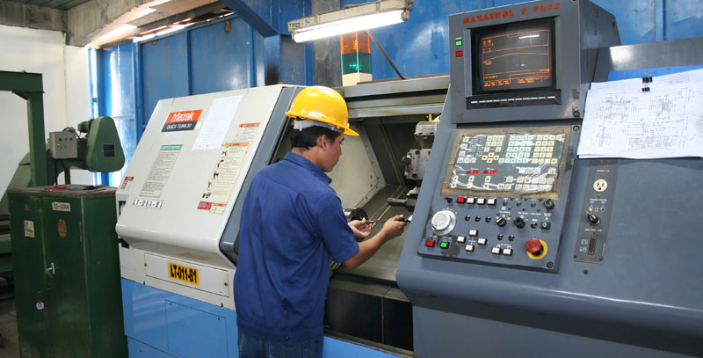
CNC Introduction
A numerical control system in which the data handling, control sequences, and response to input is determined by an on-board computer system at the machine tool.

Slide 20
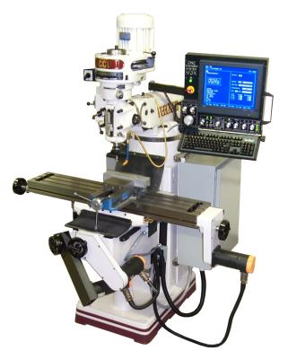
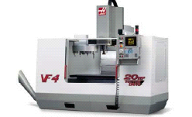
CNC Machines- How do they look like?
Servo Motors
Display Console
Coolant
control
Slides
Automated
Tool changer
Controller
Controller
Chip collection and removal

Slide 21
Elements of CNC Machine
A CNC machine consist of following 6 major elements:
  Input Device
  Machine Control Unit
  Machine Tool
  Driving System
  Feedback Devices
  Display Unit

Slide 22
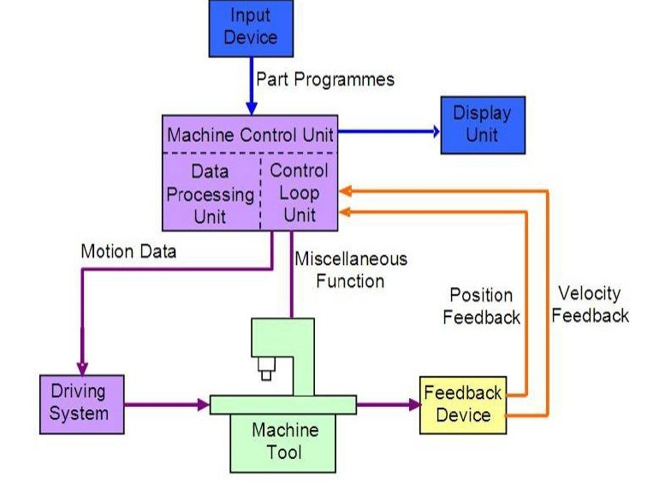
Block diagram of CNC Machine

Slide 23
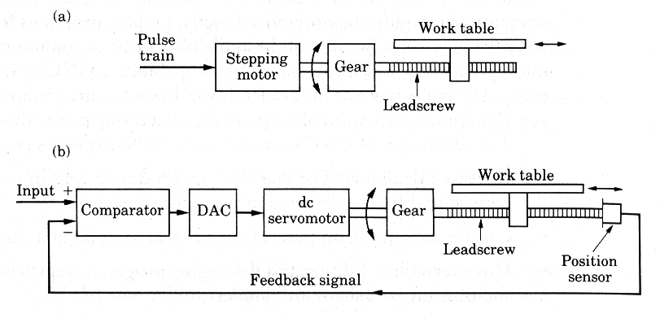
Open loop and Closed loop controls
In open loop systems the slide may overshoot or may not reach desired position because of inertia, wear and tear and friction, hence inaccurate machining.
In closed loop systems the position sensors are used to correct slide movements and achieve higher accuracy and repeatability

Slide 24
How CNC Works
Controlled by G and M codes.
These are number values and co-ordinates.
Each number or code is assigned to a particular operation.
Typed in manually to CAD by machine operators.
G & M codes are automatically generated by the computer software.

Slide 25
Features of CNC Machinery
The tool or material moves automatically.
Tools can operate in 1-5 axes.
Larger machines have a machine control unit (MCU) which manages operations.
Movement is controlled by motors (actuators).
Feedback is provided by sensors (transducers)
Tool magazines are used to change tools automatically.

Slide 26
CNC Programming Basics
CNC instructions are called part program commands.
When running, a part program is interpreted one command line at a time until all lines are completed.
Commands, which are also referred to as blocks, are made up of words which each begin with a letter address and end with a numerical value.

Slide 27
CNC programming
Important things to know:
Coordinate System
Units, incremental or absolute positioning
Coordinates: X,Y,Z, RX,RY,RZ
Feed rate and spindle speed
Coolant Control: On/Off, Flood, Mist
Tool Control: Tool and tool parameters
Programming consists of a series
of instructions in form of letter codes
Preparatory Codes:
G codes- Initial machining setup and
establishing operating conditions
N codes- specify program line number
to executed by the MCU
Axis Codes: X,Y,Z
Used to specify motion of the slide along
X, Y, Z direction
Feed and Speed Codes: F and S
Specify feed and spindle speed
Tool codes: T – specify tool number
Miscellaneous codes – M codes
For coolant control and other activities

Slide 28
Common Format of a Block
Sequence #
Preparatory Function
Dimension Words
Feed Rate
Spindle Function
Tool Function
Misc. Function
N50
G90 G01
X1.40Y2.25
F10
S1500
T01
M03
Individual Words

Slide 29
Programming Key Letters
O - Program number (Used for program identification)
N - Sequence number (Used for line identification)
G - Preparatory function
X - X axis designation
Y - Y axis designation
Z - Z axis designation
R - Radius designation
F – Feed rate designation
S - Spindle speed designation
H - Tool length offset designation
D - Tool radius offset designation
T - Tool Designation
M - Miscellaneous function

Slide 30
Table of Important G codes
G00 Rapid Transverse
G01 Linear Interpolation
G02 Circular Interpolation, CW
G03 Circular Interpolation, CCW
G17 XY Plane,G18 XZ Plane,G19 YZ Plane
G20/G70 Inch units
G21/G71 Metric Units
G40 Cutter compensation cancel
G41 Cutter compensation left
G42 Cutter compensation right
G43 Tool length compensation (plus)
G43 Tool length compensation (plus)
G44 Tool length compensation (minus)
G49 Tool length compensation cancel
G80 Cancel canned cycles
G81 Drilling cycle
G82 Counter boring cycle
G83 Deep hole drilling cycle
G90 Absolute positioning
G91 Incremental positioning

Slide 31
Table of Important M codes
M00 Program stop
M01 Optional program stop
M02 Program end
M03 Spindle on clockwise
M04 Spindle on counterclockwise
M05 Spindle stop
M06 Tool change
M08 Coolant on
M09 Coolant off
M10 Clamps on
M11 Clamps off
M30 Program stop, reset to start

Slide 32
Advantages of CNC
- Easier to program;
- Easy storage of existing programs;
- Easy to change a program
- Avoids human errors
- CNC machines are safe to operate
- Complex geometry is produced as cheaply as simple ones
- Usually generates closer tolerances than manual machines

Slide 33
Challenges
Costly setup, skilled operators
Computers, programming knowledge required
Maintenance is difficult

Slide 34
Conclusion
The advantage of a CNC system are that the operation of a conventional machine is removed and the part production is made automatic.
It reduces the labor work and hence highly efficient in the manufacturing process.
BHEL generally uses CNC machines to achieve its manufacturing targets. For manufacturing works of large scale it is very difficult to work with manual machines as they are time consuming. CNC machines have their wide scope because they are easy to handle, the work becomes easier and jobs are done with perfection.

Slide 35
Thank You

