Slide 1
FOOD PRESERVATION BY IRRAIDATION
Jai Singh
Deptt. Of Food Technology
CBL Govt. Polytechnic, Bhiwani

Slide 2
INTRODUCATION
Food irradiation is a promising new food safety technology that can eliminate disease-causing germs from foods.
The food that NASA astronauts eat has been sterilized by irradiation to avoid getting food borne illness in space.
Disease-causing germs are reduced or eliminated the food does not become radioactive dangerous substances do not appear in the foods.
The nutritional value of the food is essentially unchanged.

Slide 3
Three technology exist in the radiation
Gamma rays
X- rays
Electron beam
Radio active substance – cobalt 60, cesium 137
Unit- gray

Slide 4
Table–1: Food items approved for radiation preservation by the Ministry of Health & Family Welfare under Prevention of Food Adulteration Rules, 1955
Name of food | Purpose | Minimum Dose (kGy | Maximum Dose (kGy)
Onion |  | 0.03 0.06 0.03 0.03 0.03 | 0.09
Potato Ginger | Sprout inhibition |  | 0.15 0.15
Garlic |  |  | 0.15
Shallots (Small onion) |  |  | 0.15
Mango | Disinfestation (Quarantine) | 0.25 | 0.75
Rice Semolina (sooji, rawa), Wheat atta, maida Raisin, figs, dried dates | Disinfestation | 0.25 0.25 0.25 | 1.0 1.0 0.75
Meat and meat products including chicken | Shelf-life extension and pathogen control | 2.5 | 4.0
Spices | Microbial decontamination | 6.0 | 14.0

Slide 5
Table–2: Additional food items recommended by the Central Committee for Food
Standards for approval
Name of food | Purpose | Minimum Dose (kGy | Maximum Dose (kGy)
Pulses Dried sea- foods | Disinfestation | 0.25 0.25 | 1.0 1.0
Fresh sea- foods | Shelf-life enhancement | 1.0 | 3.0
Frozen sea- foods | Pathogen control | 4.0 | 6.0

Slide 6
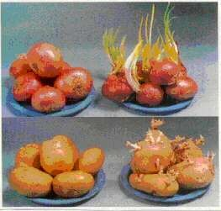
Low dose applications
Sprout inhibition in bulbs and tubers | 0.03 - 0.15 kGy
Delay of fruit ripening | 0.25 - 0.75 kGy
Insect disinfestation including quarantine treatment and elimination of food borne parasites | 0.25 - 1 kGy

Slide 7
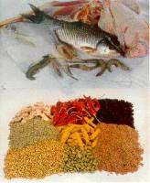
Medium dose applications
Reduction of spoilage microbes to improve shelf-life of meat, poultry and seafoods under refrigeration | 1.5 - 3 kGy
Elimination of pathogenic microbes in fresh and frozen meat, poultry and seafoods | 3 - 7 kGy
Reducing number of microorganisms in spices to improve hygienic quality | 10 kGy

