Slide 1
Characteristics of Instruments
Kanchan
Deptt of Food Technology
CBL Polytechnic, Bhiwani

Slide 2
Characteristics of Instruments
There are Two
types of
characteristics of instruments:-
1.Static characteristics of instruments
2.Dynamic Characteristics of instruments.

Slide 3
1.Static Characteristics
The static characteristics
of an instrument are required to be
considered for the instruments which measure unvarying process conditions.
The static characteristics are defined for the instruments which measure quantities which do not vary with time.

Slide 4
are :-
Accuracy
Sensitivity
Reproducibility
Drift
Static error
Dead zone
Precision
Threshold
Linearity
Stability
Range or Span
Bais
Tolerance
Hysteresis

Slide 5
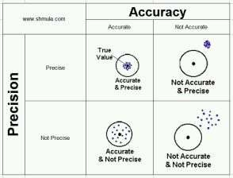
1. Accuracy
It is the degree of closeness with which an instrument reading approaches the true value of the quantity being measured.
The accuracy of a measurement indicates the nearness to the actual/true value of the quantity.

Slide 6
2.Sensitivity
Sensitivity is the ratio of change in output of an instrument to the change in input.
The manufactures specify sensitivity as the ratio of magnitude of the measured quantity to the magnitude of the response.This ratio is called as Inverse sensitivity or deflection factor.

Slide 7
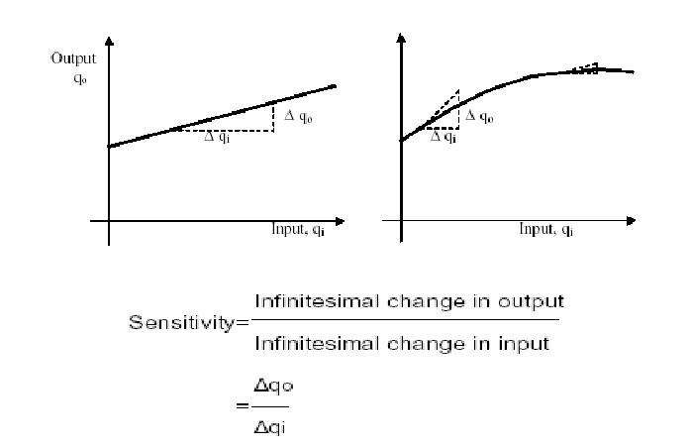

Slide 8
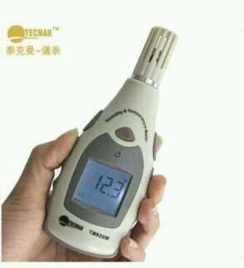
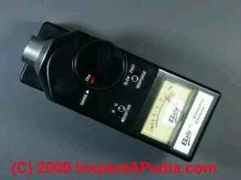
Sensitivity Meter:-

Slide 9
3.Reproducibility
Reproducibility is defined as the degree of closeness by which a given value can be repeatedly measured.
The reproducibility is specified for a period of time.
Perfect reproducibility signifies that the given readings that are taken for an input, do not vary with time..

Slide 10
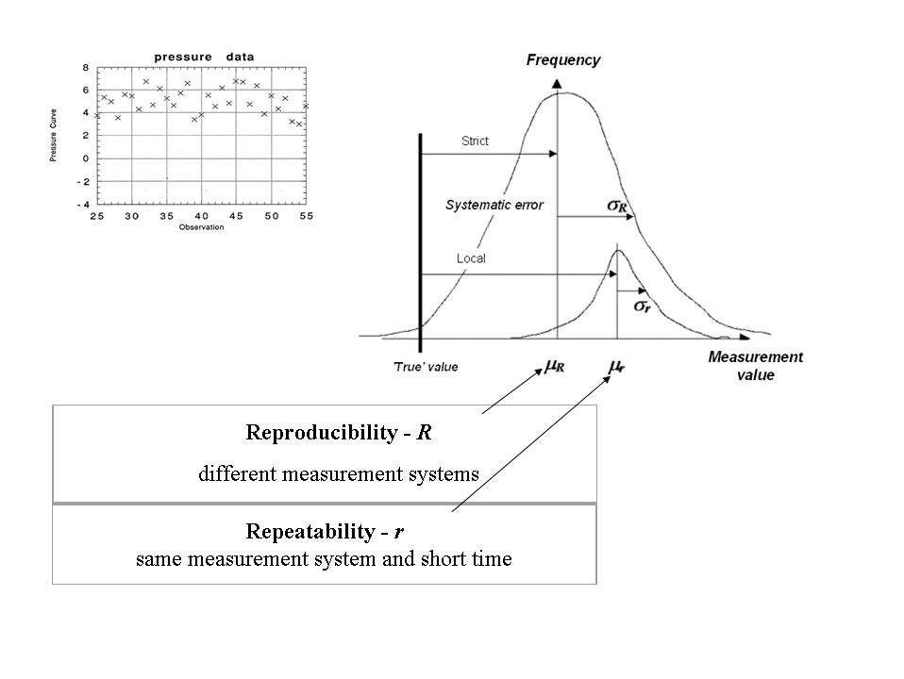

Slide 11
4.Drift
The drift is defined as the gradual shift in the indication over a period of time where in the input variable does not change.
Drift may be caused because of environment factors like stray electric fields, stray magnetic fields, thermal e.m.fs, changes in temperature, mechanical vibrations etc.
Drift is classified into three categories:
Zero drift
Span drift or sensitivity drift
Zonal drift

Slide 12
5. Static error
It is the deviation from the true value of the measured variable.
It involves the comparison of an unknown quantity with an accepted standard quantity.
The degree to which an instrument approaches to its excepted value is expressed terms of error of measurement.

Slide 13
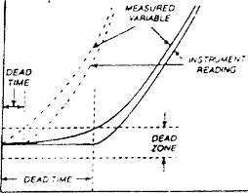
6.Dead zone
It is the largest changes of input quantity for which there is no output.
For e.g. the input that is applied to an instrument may not be sufficient to overcome friction. It will only respond when it overcomes the friction forces.

Slide 14
7.Precision
It is a measure of the reproducibility of the measurement that is given a fixed value of variable.
Precision is a measure of the degree to which successive measurements differ from each other.
For example consider an instrument on which readings can be taken upto 1∕100th of unit.
The instrument has zero adjustment error. So, when we take a readings, the instrument is highly precise. However as the instrument has a zero adjustment error the readings obtained are precise, but they are not accurate.
Thus, when a set of readings show precision, the results agree among themselves. However, it is not essential that the results are accurate.

Slide 15
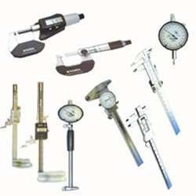
Precision Measuring instruments

Slide 16
8.Threshsold
Threshold is the smallest measurable input, below which no output change can be identified.
While specifying threshold, manufactures give the first detectable output change.

Slide 17
9.Linearity
Linearity is defined as the ability of an instrument to reproduce its input linearly.
Linearity is simply a measure of the maximum deviation of the calibration points from the ideal straight line.
Linearity is defined as,
linearity=Maximum deviation of o/p from idealized straight line ∕ Actual readings

Slide 19
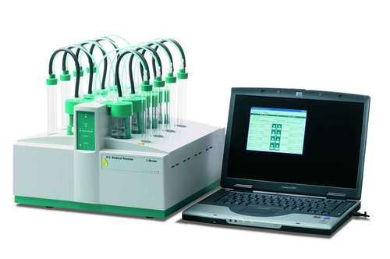
10.Stability
The ability of an instrument to retain its performance throughout its specified storage life and operating life is called as Stability.
Stability measurement instruments:-

Slide 20
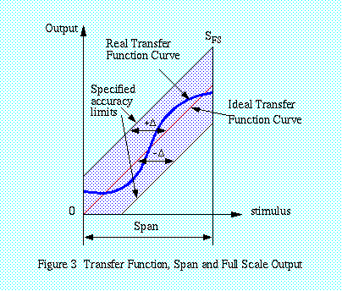
11.Range or Span
The minimum and maximum values of a quantity for which an instrument is designed to measure is called its range or span. Sometimes the accuracy is specified interms of range or span of an instrument.

Slide 21
12.Bais
The constant error which exists over the full range of measurement of an instrument is called bias. Such a bais can be completely eliminated by calibration. The zero error is an example of bais which can be removed by calibration.

Slide 22
13.Tolerance
It is the maximum allowable
error that is value while
specified in terms of certain
measurement, it is called as tolerance.
It specifies the maximum allowable deviation of a manufactured device from a mentioned value.

Slide 23
14.Hysteresis
Hysteresis is a phenomenon which depicts different output effects while loading and unloading.
Hysteresis takes place due to the fact that all the energy put into the stressed parts when loading is not recoverable while unloading.
When the input of an instrument is varied from zero to its full scale and then if the input is decreased from its full scale value to zero, the output varies. The output at the particular input while increasing and decreasing varies because of internal friction or hysteric damping.

Slide 24
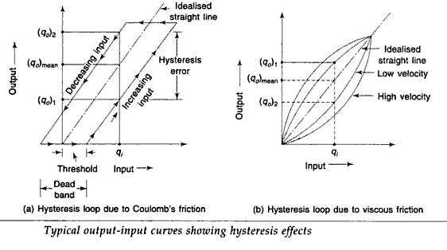

Slide 25
2.Dynamic Characteristics
Instruments rarely respond to the instantaneous changes in the measured variables.Their response is slow or sluggish due to mass, thermal capacitance, electrical capacitance, inductance etc. sometimes, even the instrument has to wait for some time till, the response occurs.
These type of instruments are normally used for the measurement of quantities that fluctuate with time.
The behaviour of such a system, where as the input varies from instant to instant, the output also varies from instant to instant is called as dynamic response of the system.
Hence, the dynamic behaviour of the system is also important as the static behaviour.

Slide 26
The dynamic inputs are of two types:
Transient
Steady state periodic.
Transient response is defined as that part of the response which goes to zero as the time becomes large.
The steady state response is the response that has a definite periodic cycle.

Slide 27
The variations in the input, that are used practically to achieve dynamic behaviour are:
Step input:-The input is subjected to a finite and instantaneous change. E.g.: closing of switch.
Ramp input:- The input linearly changes with respect to time.
III.
Parabolic
input:- The input varies to the time. This represents constant
square of
acceleration.
IV. Sinusoidal
accordance
input:- The input
changes in function of
with a sinusoidal
constant amplitude.

Slide 28
The dynamic characteristics of a measurement system are:
Speed of response
Fidelity
Lag
Dynamic error

Slide 29
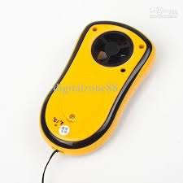
1) Speed of Response
It is defined as the rapidity with which an
the
instrument, responds to the changes in
measured quantity.
It shows how active and fast the system is.
Speed measuring instruments:-

Slide 30
2) Fidelity
It is defined
as the degree to which a
measurement system is capable of faithfully reproducing the changes in input, without any dynamic error.

Slide 31
3)Lag
Every system requires its own time to respond to the changes in input. This time is called as lag.
It is defined as the retardation or delay, in the response of a system to the changes in the input.
The lags are of two types:
Retardation lag:
As soon as there is a changes in the measured quantity, the measurement system begins to respond.
Time delay:
The response of the measurement system starts after a dead time, once the input is applied.They cause dynamic error.

Slide 32
4)Dynamic error
It is the difference between the true value of the quantity that is to be measured, changing with time and the measured value, if no static error is assumed.

